Slide 1

TOAD

Slide 2
INTRODUCTION TO TOAD(Tools for Oracle Application Development)
Toad- is a set of development tools used for application development, database development, or business intelligence and assist developers in deploying Oracle-based applications and Web services on the Windows platform.

Slide 3
Why Toad?
Automation-Reduce the risk of manual errors by automating complex and repetitive tasks like schema compare, script execution, administration, reporting and more.
PL/SQL code profiling-Easily determine why your code is executing slowly by visually exposing performance bottlenecks.
Team collaboration-Share standards, best practices, code, scripts, artifacts and more with your team or across the development organization.

Slide 4
Data Modelling -Define the most efficient data structures before building your schemas and reverse engineer existing data structures.
Data privacy and auditing-Leverage Oracle’s Data Redaction, Transparent Data Encryption features and audit policies to secure and track data access
Database performance diagnostics-Quickly pinpoint and resolve database performance inefﬁciencies.
Simplified SQL Optimization-Simplify and automate SQL optimization for developers; advanced SQL and index optimization for DBAs.

Slide 5
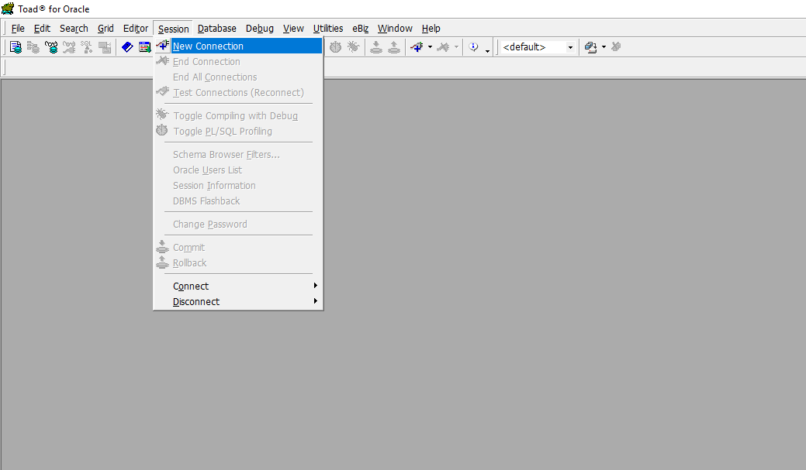
TOAD KEY FEATURES

Slide 6
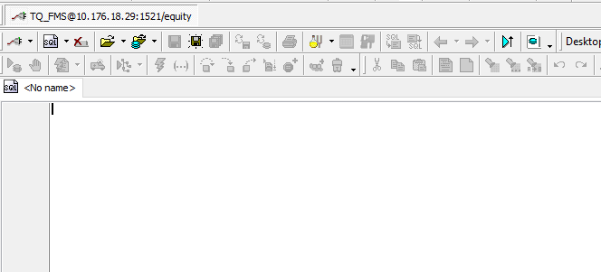
Toad Connects to the Oracle Database using the Session>>New Connection shown above
The host ID, the port & the DB name are then keyed in.
Once the DB is connected, the editor is displayed. This is the screen you run the sql queries, packages & procedure scripts

Slide 7
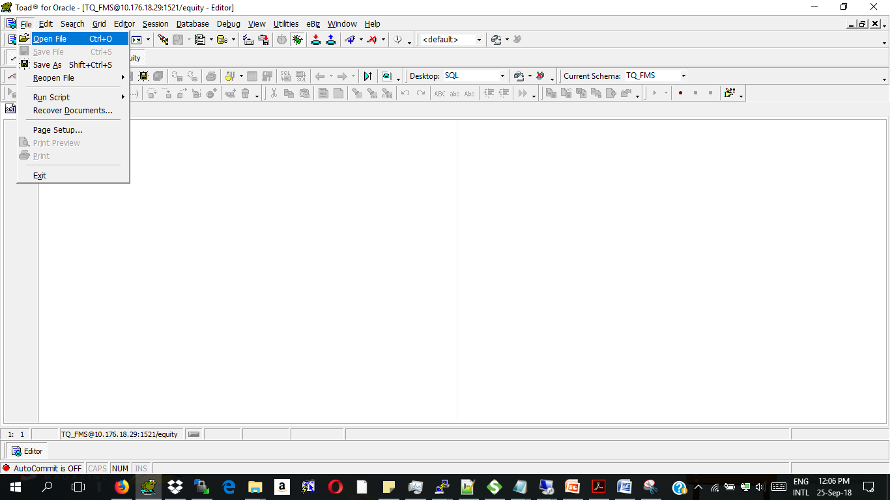
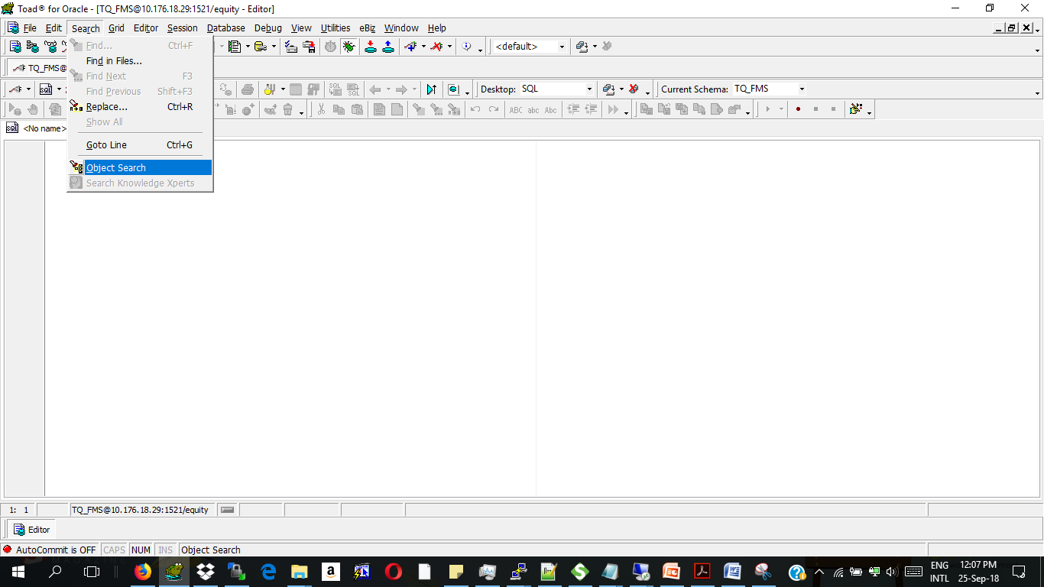
TOAD MENUS
1. The File Menu- This is the menu that allows you to pick the files/scripts that you want to run in toad.
2.Search- The object Search options allows you to search for specific objects within the Database eg procedures, tables, sequences etc

Slide 8
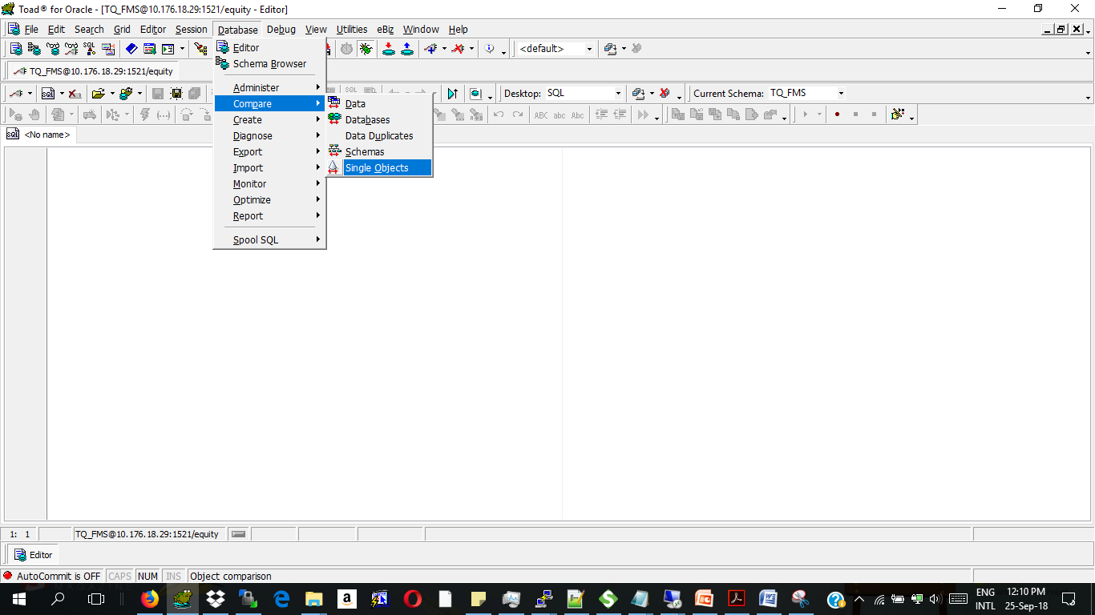
3.Database Menu- It allows you to compare schema objects between two databases
On the Database>>Monitor>Session browser- The developer can track which sessions are locking & even the objects that are causing the locks.

Slide 9
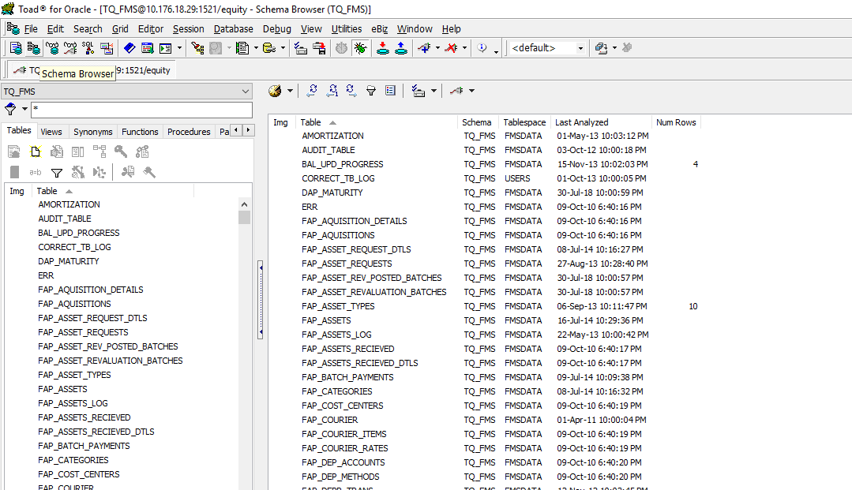
4.Schema Browser-
The schema browser is
able to display all the
database objects eg:
Tables
Views
Synonyms
Procedures
Functions
Packages
Types
Triggers
Indexes
Constraints
Sequences

Slide 10
Tables-Stores the records saved to the database.
Views-A view is a virtual table which derives its data from one or more than one table columns. It is stored in the database. View can be created using tables of same database or different database.
Synonyms-A synonym is an alternative name for objects such as tables, views, sequences, stored procedures, and other database objects. You generally use synonyms when you are granting access to an object from another schema and you don't want the users to have to worry about knowing which schema owns the object.
Procedures-A procedure is a group of PL/SQL statements that you can call by name.
The improve performance since different areas of code can call that specific procedure
They reduce code redundancy
Functions-A stored function (also called a user function or user-defined function) is a set of PL/SQL statements you can call by name. Stored functions are very similar to procedures, except that a function returns a value to the environment in which it is called
Packages-A package is a schema object that groups logically related PL/SQL types, variables, constants, subprograms, cursors, and exceptions. A package is compiled and stored in the database, where many applications can share its contents. They offer important features for reliable, maintainable, reusable code.
Packages usually have two parts, a specification (spec) and a body;. The specification is the interface to the package. It declares the types, variables, constants, exceptions, cursors, and subprograms that can be referenced from outside the package.
The body is encapsulated collection of related procedures, stored functions, and other program objects stored together in the database

Slide 11
Types- The %TYPE attribute, used in PL/SQL variable and parameter declarations, is supported by the data server. Use of this attribute ensures that type compatibility between table columns and PL/SQL variables is maintained. ... The data type of this column or variable is assigned to the variable being declared.
Triggers- Oracle lets you define procedures called triggers that run implicitly when an INSERT , UPDATE , or DELETE statement is issued against the associated table or, in some cases, against a view, or when database system actions occur. ... Triggers are similar to stored procedures
Indexes- Indexes are used in Oracle to provide quick access to rows in a table. Indexes provide faster access to data for operations that return a small portion of a table's rows. Although Oracle allows an unlimited number of indexes on a table, the indexes only help if they are used to speed up queries.
Constraints- a rule that restricts the values in a database
Sequences- is an object in Oracle that is used to generate a number sequence. This can be useful when you need to create a unique number to act as a primary key.

Slide 12
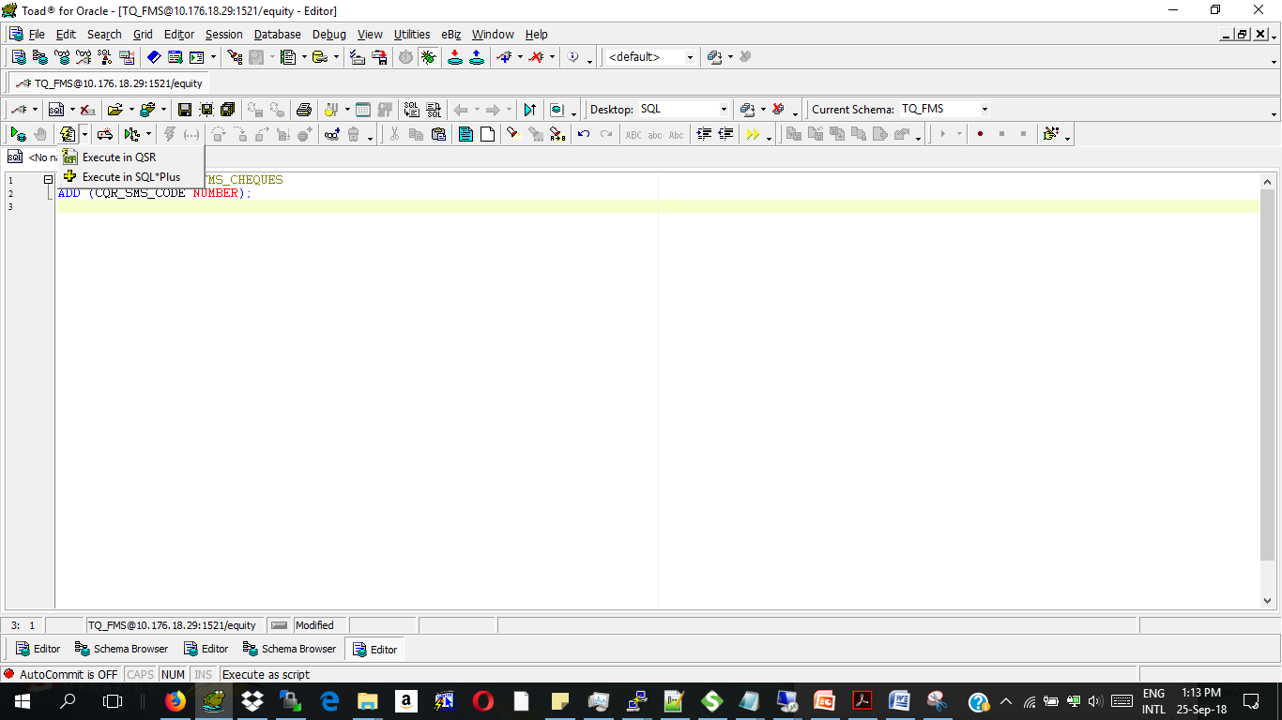
UPDATES IN TOAD
Running SQL SCRIPTS
To run an sql script in Toad- Press F5 OR use the script icon below:
1.Example of a table script:
ALTER TABLE TQ_FMS.FMS_CHEQUES
ADD (CQR_SMS_CODE NUMBER);
The above script adds a column to the table in question
2.Running a type script:
Create the object first then the tab(A tab reads the objects records)
CREATE OR REPLACE TYPE TQ_FMS."BNK_PAYMENT_METHODS_OBJ" AS OBJECT
(
BPM_CODE NUMBER (8),
BPM_PM_CODE VARCHAR2 (10),
BPM_BCT_CODE NUMBER (8),
BPM_BCT_BRH_CODE NUMBER (15)
);
/
CREATE OR REPLACE TYPE TQ_FMS."BNK_PAYMENT_METHODS_TAB" AS TABLE OF BNK_PAYMENT_METHODS_OBJ;
/

Slide 13
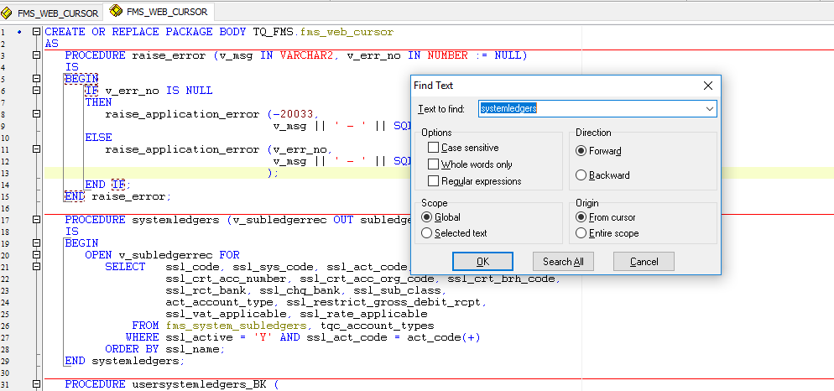
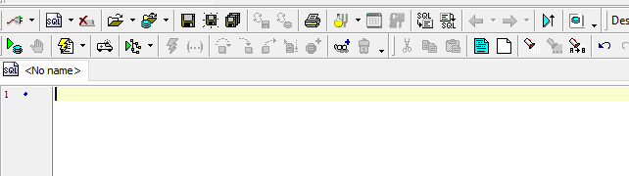
3. Updating a procedure or a function in the package.
Load the package. Ctrl+F(Find the procedure you are to replace). Highlight the procedure & replace.
Once the procedure is updated, compile the package using F9 OR the compile button below:

Slide 14
THANK YOU

